Slide 1
Class - 01
Topic:
Introduction
Language definition overview
Character Set
Variable

Slide 3
Hello Everybody

Slide 4
What is Language:
Language is a way to communicate with each others(Human)
Ex: Bengali, English and etc.
What is computer language:
Computer also have a language to execute its task..
Ex: 0 or 1
What is programming language:
A programming language is a human readable & understandable language by which we can give instructions to computer.

Slide 5

Source code
Compiler

Slide 6
C programming language:
It is a programming language that is developed by Dennis Ritchie in 1972 at the Bell Laboratories..
Real life application of C:
Operation System: windows, Linux. (Kernel)
Games

Slide 7
Required Software:
1. Code Blocks IDE latest version

Slide 8
A Sample Program:
#include<stdio.h>
int main() {
printf(“Hello World\n”);
return 0;
}

Slide 9
Character Set:
1. Letters (A-Z and a-z)
2. Digits(0-9)
3. Special Characters
Special Character:
+ - * / % , . ! @ # $ % ^ & ( ) { } ` ` “ “ \ / < > ~ = | _ ?
White space, Blank space, horizontal tab, New line

Slide 10
Variable(Identifiers):
A variable is container to hold data in computer.
variable_type variable_name;
Example: int bigNumber;
declaration rule:
1st character must be an alphabet or underscore.
Allows letters, digits or underscore
Not allow a Keyword(Reserved for C language)
Not allow white space

Slide 11
Variable Example:
int main() {
int num1;
int num1, num2, a, A, _number, digit;
}

Slide 12
Class - 02
Topic:
Data type
Data type specifier
Printf Function
Scanf Function

Slide 13
Previous Class Discussion
Character Set
Variable?
Variable is a data container
Variable Declaration?
Variable_type variable_name;
datatype name;

Slide 14
Data & Data type:
134.55
“134.56”
Data:
“1000000”
1402007
“12345”
‘4’
“Abir Rahman”
“Abir Rahman”
“A”
‘A’

Slide 15
Data type:
Data Type | Short form | Specifier
Integer | int | %d
Float | float | %f
Character | char | %c

Slide 16
Printf Function:
It is used to give output on the console.
writing format:
printf(“……”);
printf(“Hello Progrmmer!!”);
printf(“%d”, roll);
printf(“My id: %d”, id);
printf(“GPA: %c”, gpa);

Slide 17
Scanf Function:
It is used to take input from user
Writing format:
scanf(“……”);
scanf(“data specifier”, &variable_name);
scanf(“%d”, &roll);
scanf(“data-spacifier1, data-specifier2”, &var1, &var2);
scanf(“%d %d”, &var1, &var2);

Slide 18
Home Work:
Write a program to print “Hello World!!”.
Write a program to print 3 numbers.
Write a program to print 2 numbers and 1 character.

Slide 19
Data type | Variable name | Memory Address | Value
int | var | 0 | 12345
int | number | 1 | 500
int | abir | 2 | 3022222
int | akbar | 3 | 44557

Slide 20
Class - 03
Topic:
Variable declaration & initialization
Variable value & address
Various type input & Output format

Slide 21
Previous class discussion
Data type:
Integer : int specifier: %d (used in printf & scanf)
int number1, number2;
scanf(“%d %d”, &number1, &number2);
Float: float specifier: %f (used in printf & scanf)
float number3, number4;
scanf(“%f %f”, &number3, &number4);
Character: char specifier: %c (used in printf & scanf)
char character1, character2;
scanf(“%c %c”, &character1, &character2);

Slide 22
Variable declaration & initialization:
Only declaration:
int var1, var2; // variable declaration
Declaration with initialization:
int var3 = 580, var4 = 0, var4 = 200; // variable initialization
Declaration then initialization:
int var5;
var5 = 567;
Garbage Value:
int var6 // it contains a garbage value

Slide 23
Variable value and address:
address: 01 address: 02 address: 03
Variable_Name: number1
Address: 05
Value
value
value
s
Value

Slide 24
Various type input and output:
int aab, babar, x, y;
float bcc1, ddr;
char abur, m, n;
scanf(“ %d %f %c %c %d ”, &aab, &ddr, &m, &n, &x);
printf(“%0.2f %d %c ”, ddr, x, n, );

Slide 25
Message in Printf Function:
printf(“ Please Enter a number:”);
printf(“My name is : Mohammad Akbar”);
let’s go to codeblocks for coding session:

Slide 26
Class - 04
Topic:
operators
Bit, Byte intro
Code session with some problems

Slide 27
Previous Class Discussion
Data Type
Integer: int scanf(“%d”, &var1); printf(“%d”, var1);
Float : float scanf(“%f”, &var1); printf(“%0.2f”, var1);
Character: char scanf(“%c”, &var1); printf(“%c”, var1);
Variable
Declaration: int var1;
float var2;
char var3;

Slide 28
Initialization: int var4 = 120, var5, var6 = 150, var7;
int var8;
var8 = 130;
int var9 = 345;
var8 = var9;
int var10, var11;
var11 = 54;
var11 = var10;

Slide 29
Operators: an operator is a symbol that tells the computer to perform mathematical or logical operations.
Ex: sum = number1 + number 2
sub = number1 - number2
div = number1 / number2
multi = number1 * number2
Arithmetic operators
Assignment operators
Increment and decrement operators

Slide 30
sum = number1 + number2
operators
operand

Slide 31
Arithmetic operators: addition, subtraction, multiplication, division and modulo divison(%).
example: number1 = 36, number2 = 12
sum = number1 + number2
sum = 36 + 12
sum = 48
sub = number1 - number2
sub = 36 - 12
sub = 24

Slide 32
Multi = number1 * number2
Multi = 36 * 12
Multi = 432
Div = number1 / number2
Div = 36 / 12
Div = 3
Modulo = number1 % number2
Modulo = 36 % 12
Modulo = 3

Slide 33
Bit: is a unit memory cell that can store 1 or 0
One bit:
Eight bit: = 1 byte
1
0
Sign bit
Left most bit
Right most bit

Slide 34
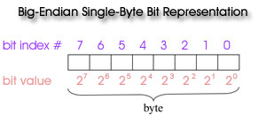

Slide 35
Class - 05
Topic:
Operators
Relational operators
Logical operators
Increment & decrement operators
Expression
Precedence of arithmetic operators
Expression evaluation

Slide 36
Previous class discussion

Slide 37
Relational Operators:
It helps to compare between the value of two variables or constants.
Exp: var1 < var2, it gives 0 or 1 as a result
17 < 288 , it will give 1
17 > 288, it will give 0
remember If(conditions) checks only 0 or 1 value
x < y, x > y, x <= y, x >= y, x == y, x != y
lets go to coding session

Slide 38
Logical operators:
it helps to combine more than one condition.
operators:
&& ->AND
|| ->OR
! -> NOT

Slide 39
Precedence of relational and logical:
highest !
> >= < <=
== !=
&&
lowest ||

Slide 40
Increment & decrement:
increment: increase value by 1
like x = x + 1 OR x++
decrement: decrease value by 1
like x = x – 1 OR x--
BUT, x++ and ++x is same?
x-- and --x is same?

Slide 41
Home Work
Write a program to find the
Algebra equation:
ax + by + c = 0
x = y,
x = a,
a.a + b.y + c = 0

Slide 42
sum = var1 + var2;
Operators =, +, -, /, *,
Operand: variable

Slide 43
Class - 06
Topic:
ASCII value

Slide 44
Ascii Value
A, b C, D, E,
A = 65 = 1000001
B = 66 = 1000010
C = 67 = 1000011
M L
A, B, C, D, E,,,,,,,, Z
1, 2, 3, 4,
Z,

Slide 45
1001001 = 1*2^6 + 0*2^5

Slide 46
Class -07
Topic:
Increment / decrement operator
Loop: for loop structure & Program

Slide 47
2
Int var = 2; var = 50 – 48;
5
Int var = 5; var = 53 – 48;
8
Int var = 8; var = 56 - 48;
‘0’ = 48
48 + 1 = 49 => ‘1’
48 + 2 = 50 => ‘2’
A + B = Y
B = Y - A

Slide 48
Increment / decrement operator:
Increment means it increases the value of a variable by one
X++ OR X = X + 1 is same operation
X = 5;
X++ ; // now the value will be X = 6;
Decrement means it decreases the value of a variable by one
X-- OR X = X -1 is same operation
X = 10;
X--; //now the value will be X = 9

Slide 49
Important
X++ and ++X they perform same operation but there is a different:
If X = 7;
Y = X++; // what will be Y = 7?
If X = 10;
Y = ++X; // what will be Y = 11?

Slide 50
Important
X-- and --X they perform same operation but there is a different:
If X = 121;
Y = X--; // what will be Y = 121? X = 120
If X = 233;
Y = --X; // what will be Y = 232? X = 232

Slide 51
Loop:
It repeats the same operation or instruction in a block. {…..}
Can you print number from 1 to 10?
Student: yes it is very easy. I will take ten printf function..
like: printf(“%d”, 1);
printf(“%d”, 2);
……………………….
………………………..
………………………..
printf(“%d”, 10);

Slide 52
Can you print number from 50 to 1000????
Student: wow…….
this is possible but I need a long time to write 1000 – 50 printf
Function……

Slide 53
Instead of writing thousand printf function… we can write only one printf function and will write this one printf function into a feature of C programming which will print our 1000 printf… that is known as LOOP….
X = 50;
While(X <= 1000){
printf(“%d\n”, X);
X++;
}
There are two 3 types of loop:
1. for loop
2. while loop
3. do… while loop

Slide 54
While Loop:
while( test condition) {
body of loop
}

Slide 55
n = 1;
while(n < 11) { Exit
printf(“Hello\n”);
n = n + 1;
}

Slide 56
Class - 08
do while loop
for loop
Break
Continue

Slide 57
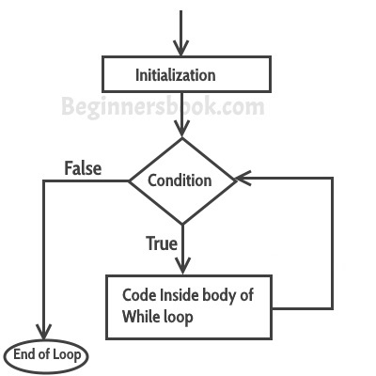
Previous Class Discussion
while loop:
while(condition) {
body….
………..
}

Slide 58
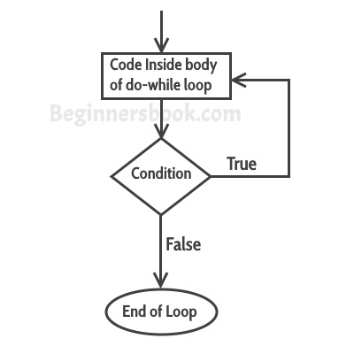
do while loop: it works look like while loop but there is a different. Find it.
do {
printf(“Hello\n”);
}while(condtion);
NB: going to code block

Slide 59
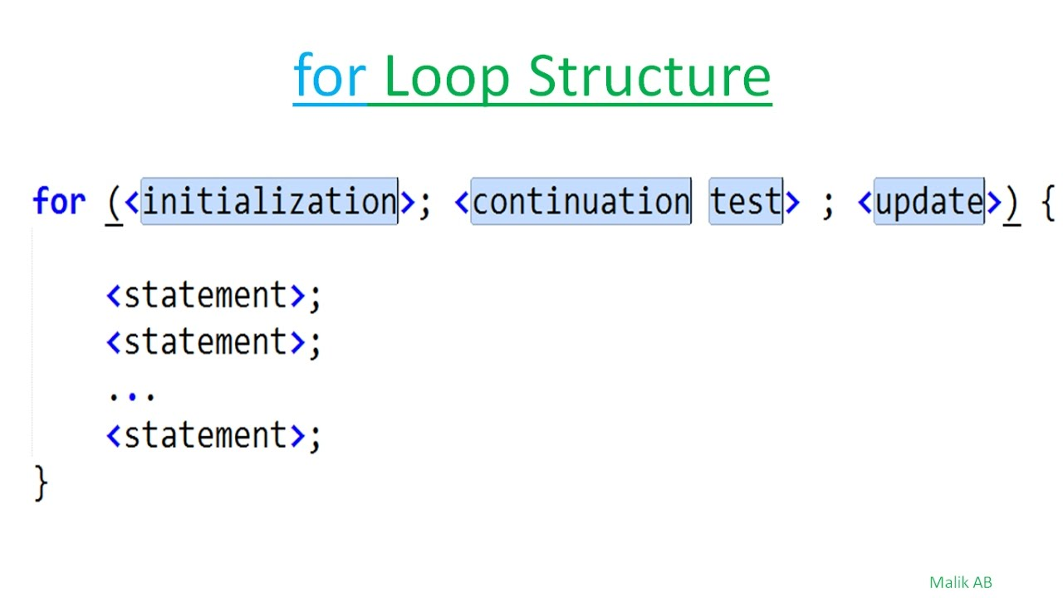
for loop: It also repeats the task till condition false.

Slide 60
Class - 09
Topic:
Relational Operators
Logical Operator Truth Table
Operator precedence
Compound condition
Nested loop

Slide 61
Previous Class Discussion
For loop:
Loop controlled update: increment / decrement / multiplication / division / modulo
for( initialization; condition; loop controlled update) {
loop body
}
for( int i = 1; i <= n; i++) {
printf(“%d\n”, i);
}
condition
Loop controlled update
initialization

Slide 62
While loop:
Initialization
while( condition ) {
body…
loop controlled update: increment / decrement / multiplication / division / modulo
}
int i = 1;
while( i <= 100 ) {
printf(“%d\n”, i);
i++;
}

Slide 63
Do while loop:
int i = 1;
do {
printf(“Ayon\n”);
i++;
}while(i < = 10 );

Slide 64
Relational operators:
It compares between two values and gives result as 1(true) or 0(false).
There are six relational operators:
<
<= a < b || a == b
>
>=
==
!=
A <= B it is a relational expression or condition. That have two values either 0 or 1
if(condition) { if( ) condition: 0 /1
body
}

Slide 65
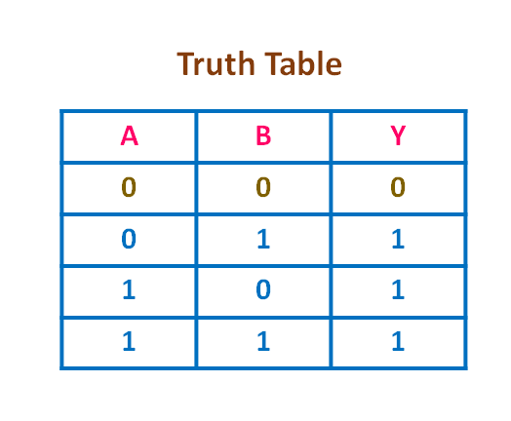
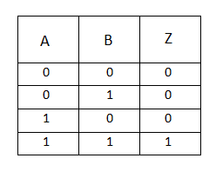
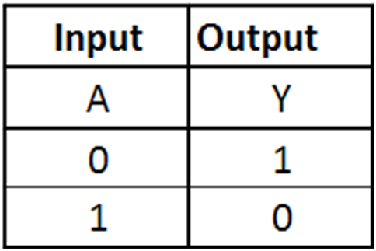
Boolean Truth Table:
||
&&
!

Slide 66
Operator precedence:
Highest !
>, >=, <, <= ( L to R )
==, != (L to R)
&&
Lowest ||
If(!x) printf(“Yes”); if( !34) = if(!1) = if(0)
If(!0) = if(1) = yes

Slide 67
Compound logic:
If( a <= b && x > y) {
printf(“YES”);
}
Else {
printf(“NO”);
}
Fa = 3, b = 5, x = 100, y = 50
If( 3 <= 5 && 100 > 50) <=, &&, >
<=, > , &&
If( 1 && 1)
If(1)
Pf(yes)
Fa = 3, b = 5, x = 30, y = 50
If(3<=5 && 30>50) <= , && , >
<=, >, &&
If( 1 && 0)
If(0)
Else pf(“no”)

Slide 68
Compound:
If( a + b < x && b + c > y || a – z == m) pf(“yes”)
If(1+2 < 5 && 3 + 2 > 2 || 1 – 5 == 1)
If(3 < 5 && 5 > 2 || -4 == 1)
If(1 && 1 || 0)
If( 1 || 0)
If(1)
If( (a + b < x ) && (b + c > y) || (a-z == m) ) pf(“yes”)
If( ( (a + b) <x ) && ( (b + c) > y) || ((a-z) == m )) pf(“yes”)

Slide 69
Nested loop
Can you print following pattern using single loop?
1
12
123
1234
12345
Can you print this using loop
*
* *
* * *
* * * *

Slide 70
Class -10
Topic:
Additional features of for loop
Nested loop
Array

Slide 71
Previous Class Discussion
Compound Logic:
If( x + y/2 – m > 10 && x ==z || !m) pf(yes)
Operator precedence:
Highest !
>, >=, <, <= ( L to R )
==, != (L to R)
&&
Lowest ||

Slide 72
Nested loop:
while(condition) {
while(conditon2) {
}
}
Even Mission Problem Solution.

Slide 73
Additional features of for loop:
Initialization more than one variable
for(int i = 0, j = 1, m=0; i < 100; i++) {…..}
for(int I = 0, j = 1; i < 100 && j < 200; i+=2, j *= 2) {….}
for( int i = (m+n); i < 100; i += m) {…..}
2. int i = 5;
for( ; i < 20; i++) {……}

Slide 74
Nested Loop: It means a loop contain one or more loop inside it.
Container = outer loop
Contained = inner loop
for(i = 0; i <= 10; i++){
for(j = 0; j <= 10; j ++) {
Printf(“i = %d j = %d “, i, j);
}
}
while(n <= 3) {
while(m <= 4) {
printf(“%d %d\n”, n, m);
}
}

Slide 76
Array: An Array is a sequenced collection of related data items that share a common name.
if I ask to store marks of 5 students:
int std1, std2, std3, std4, std5;
scanf(“ %d %d %d %d %d, &std1, &std2, &std3, &std4, &std5);
But if you have to store marks of 1000 students, then what will you do??
int std1, std2, std3, …………………………………… std999, std1000;

Slide 77
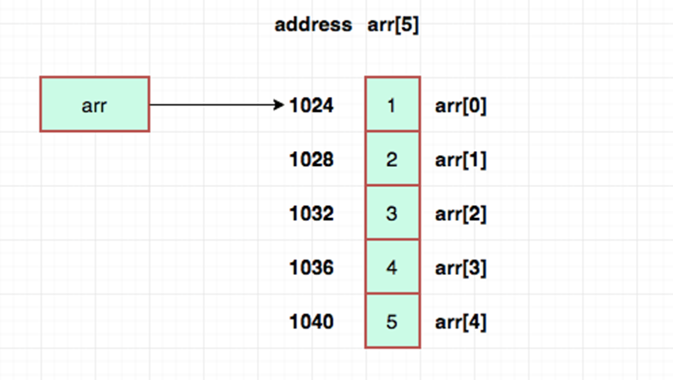
Array Declaration:
int std1, std2, std3, std4, std5;
int std[5];
// it will creates like: std[0], std[1], std[2], std[3], std[4]

Slide 78
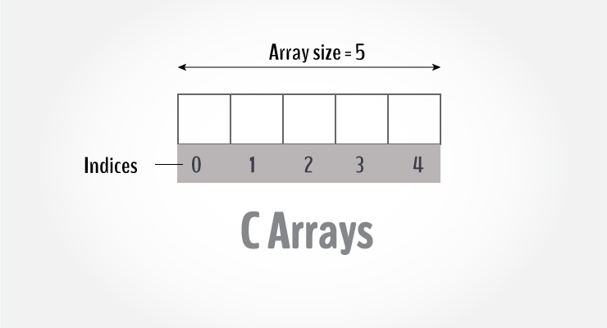

Slide 79
Class-11
Topic:
Nested loop
Array declaration
Array initialization
Array traversing
Array accesing

Slide 80
Nested Loop:
Print 1 to 5 numbers
Solution:
printf(“%d”, 1);
printf(“%d”, 2);
printf(“%d”, 3);
printf(“%d”, 4);
printf(“%d”, 5);
Print 1 to 10000
You must use loop
For(i = 1; i <= 5; i++) printf(“%d “, i);

Slide 81
1, 2, 3, 4, 5, . . . . . . . . . . . . . . . .N
1, 2, 3, 4, 5, . . . . . . . . . . . . . . . . N
1, 2, 3, 4, 5, . . . . . . . . . . . . . . . . N
1, 2, 3, 4, 5, . . . . . . . . . . . . . . . . N
1, 2, 3, 4, 5, . . . . . . . . . . . . . . . . N

Slide 82
1, 2, 3, 4, 5, . . . . . . . . . . . . . . . .N = 1
1, 2, 3, 4, 5, . . . . . . . . . . . . . . . . N = 2
1, 2, 3, 4, 5, . . . . . . . . . . . . . . . . N = 3
1, 2, 3, 4, 5, . . . . . . . . . . . . . . . . N = 4
1, 2, 3, 4, 5, . . . . . . . . . . . . . . . . N = 5
. .
. .
. .
. .
1, 2, 3, 4, 5, . . . . . . . . . . . . . . . . N = N

Slide 83
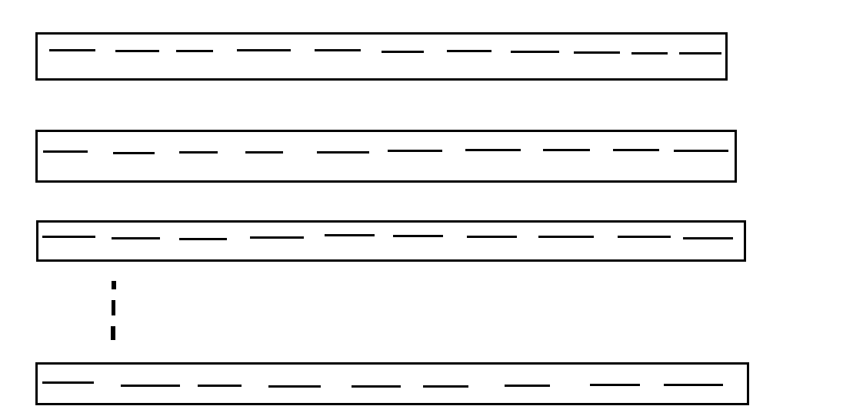
Nested loop:

Slide 84
Array discussion

Slide 86
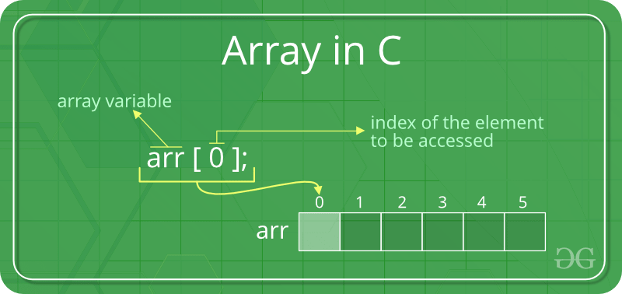

Slide 88
Class - 12
Topic:
Array Declaration
Array Initialization
Array Manipulation

Slide 89
Array declaration:
Data_type variable_name[size];
int arr[100]; you can keep size max: 10^6 TLE: 1s.
float arr[100];
double arr[100];

Slide 90
Array index number and index value:
Array index is always integer type. But the values can be integer or float or double or characters.
0 1 2 3 4
0 1 2 3 4
0 1 2 3 4
1s100 23 3434 129323 -32424
123.1223 345.12 12.98 -125.45 123.00
1A C a d e

Slide 91
Array initialization:
Compile time
Runtime time
Compile time:
int arr[5] = {12, 45, 89, 0, 123};
charcter arr[5] = {‘n’, ‘e’, ‘w’, ‘0’, ‘m’};
double arr[5] = {123.123, 3409.34, 456.87, 34.12, 89.42};

Slide 92
Run time initialization:
int arr[10];
for( int i = 0; i < 10; i++ ) {
scanf( “ %d “, & arr[i];
}

Slide 93
Array Manipulation:
Array accessing: arr-name[index-number]
Value accesing:
X = arr[34]; //
Value assigning
arr[5] = 298; //

Slide 94
1D array
Array traversing:
int arr[10];
for(int I = 0; I < 10; I++) {
printf(“%d “, arr[I]);
}

Slide 95
Class-13
Topic:
Character I/O
Character test functions

Slide 96
Previous class discussion
Array Declaration
Array Accessing
Array Traversing

Slide 97
Character I/O:
Character input can be done by using “scanf()” function or “getchar()” function.
Scanf(“%c”, &ch);
Or
ch = getchar();

Slide 98
Character I/O:
Character output can be done by using “printf()” or “putchar()” function.
printf(“%c”, ch);
Or
putchar(ch);

Slide 99
Unwanted Character:
int n;
char ch;
scanf(“%d”, &n);
scanf(“%c”, &ch);
printf(“%d %c”, n, ch); what will be output?
To avoid unwanted characters, use “fflush(stdin)” function;

Slide 100
Class-14
Topic:

